Slide 1

TRAINING OF TRAINERS MANUAL
FACILITATOR’S NOTES SLIDE
This slide deck accompanies the Training of Trainers Manual: Preventing Gender‑Based Violence (GBV) in Conservation Programming. It is designed to support facilitators by highlighting key points, providing visual aids, and offering a clear structure for workshops. It should be used together with the manual, rather than on its own.
NOTE:
Feel free to adapt this deck to your needs and context by making a copy of this presentation. Template slides have been provided for you to add your own activities or key points.
Notes:
1

Slide 2

TRAINING OF TRAINERS MANUAL:
Preventing Gender Based Violence in Conservation Programming
Workshop Day 1: Foundational Gender Knowledge
DATE:
DDMMYYYY
VENUE:
Insert venue here
Facilitators: click the date and venue above to type your own.
Notes:
2

Slide 3

TRAINING OF TRAINERS MANUAL
WORKSHOP DAY 1
FOUNDATIONAL GEDSI KNOWLEDGE
DATE:
DDMMYYYY
VENUE:
Insert venue here
Facilitators: click the date and venue above to type your own.
Notes:
3

Slide 4

DAY 1 · FOUNDATIONAL GENDER KNOWLEDGE
TIME
ACTIVITY
NOTES
DAY 1 AGENDA
9.00
1.0
Registration, Official Welcome to the Workshop
9.30
1.2
Introduction, Workshop Expectations, Pre-Assessment
10.00
1.3
Spirit of the Workshop: Workshop Goals, Concerns, Expectation and Norms
10.00
1.4
Aliens! Exploring Gender Roles and Identities
10.45
BREAK
11.00
1.5
1.6
Gender Concepts Summary Optional Activity: Vote with Your Feet: Gender vs Sex
12.00
LUNCH
13.00
1.7
1.8
Introducing Genderbread Person Optional Activity: Summary of SOGIESC
13.45
1.9
1.10
1.11
Gender and Social Norms
Optional Activity: Changing Social Norms
Optional Activity: What would you do?
14.30
BREAK
14.45
1.12
24 Hours Clock
15.45
1.13
Pile Sorting
16.45
1.14
Power Walk
17.30
Daily Recap
TRAINING OF TRAINERS MANUAL
Notes:
3

Slide 5
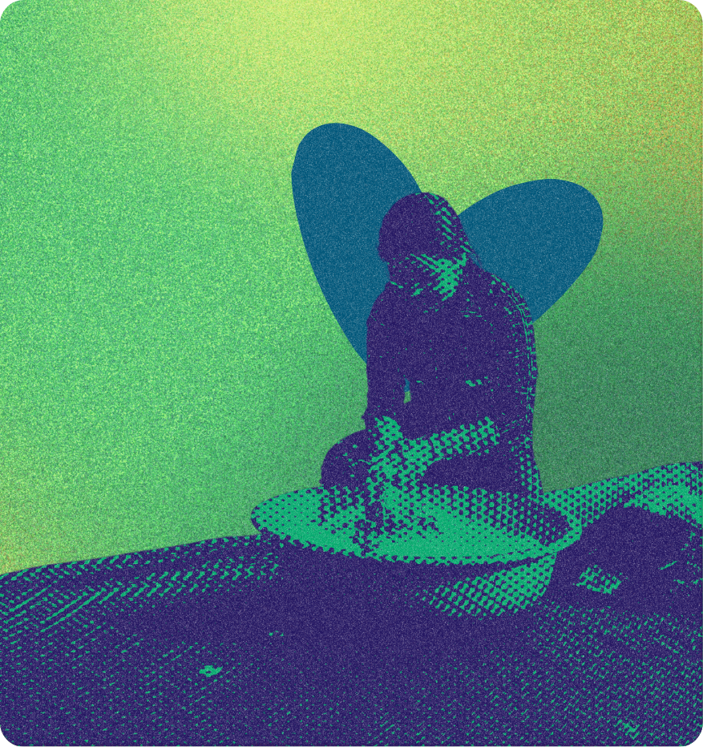
DAY 1 · FOUNDATIONAL GENDER KNOWLEDGE
WORKSHOP OBJECTIVES
Build foundational knowledge of Gender Based Violence (GBV), safeguarding and protection principles in conservation programming.
Strengthen understanding of how gender inequality, social exclusion, and power dynamics influence GBV risks.
Equip participants with tools to identify and mitigate GBV risks in project design, implementation, monitoring, and community engagement.
Promote survivor-centered, ethical, and culturally informed approaches to responding to disclosures and incidents.
Develop participants' facilitation and training skills to enable replication of learning within their organizations and networks.
Support action planning for integrating GBV prevention into conservation policies, systems, and field operations.
Activity 1.3 - Workshop Principles: Goals, Concerns, Expectations & Shared Norms
TRAINING OF TRAINERS MANUAL
Notes:
4

Slide 6

DAY 1 · FOUNDATIONAL GENDER KNOWLEDGE
WORKSHOP AT A GLANCE
DAY 1
DAY 2
DAY 3
DAY 4
FOUNDATIONAL GEDSI KNOWLEDGE
FOUNDATIONAL GBV KNOWLEDGE
GBV AND CONSERVATION
PRACTICE YOUR FACILITATION SKILLS
  Purpose
  Purpose
  Purpose
  Purpose
Lay the foundations of Gender Equality, Disability and Social Inclusion knowledge to foster gender awareness and shared understanding about gender concepts among participants.
Increase understanding of GBV, its consequences, and identify resources for support within the community context.
Provide participants with the knowledge and tools to identify key linkages between GBV, climate change and conservation within their community’s context.
Provide participants with the opportunity to practice facilitation skills on gender thematic training, drawing on their own experiences and learning from peers.
TRAINING OF TRAINERS MANUAL
Notes:
5

Slide 7
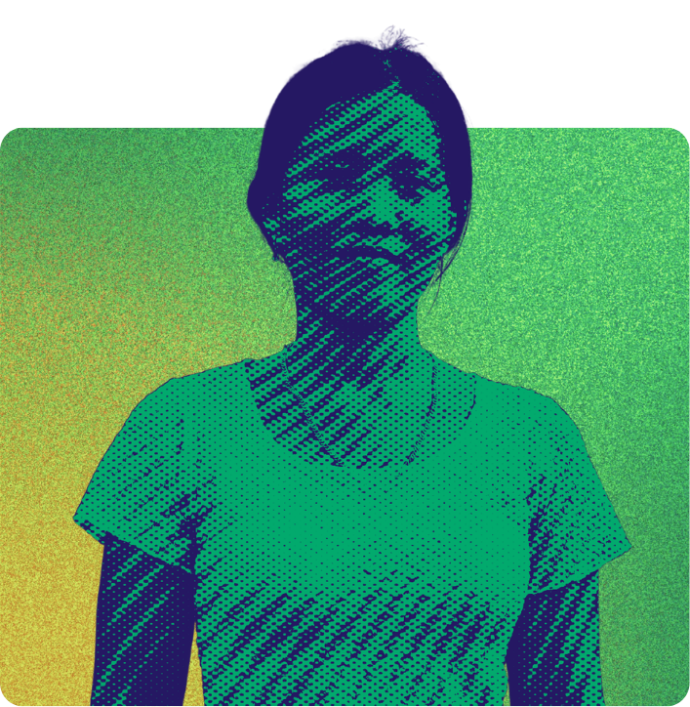
DAY 1 · FOUNDATIONAL GENDER KNOWLEDGE
ESTABLISHING GROUP NORMS
“
What norms or ground rules can we agree on to hold each other accountable for during this workshop?
”
Activity 1.3 - Workshop Principles: Goals, Concerns, Expectations & Shared Norms
TRAINING OF TRAINERS MANUAL
Notes:
6

Slide 8

DAY 1 · FOUNDATIONAL GENDER KNOWLEDGE
ALIENS! EXPLORING GENDER ROLES AND IDENTITIES
●
Imagine aliens have arrived in your area.
●
These aliens are genderless and do not understand categories like men, women, or other genders.
●
They want to know how to tell the difference.
Can you help them?
Draw a woman, man, or other gender based on your context.
Make a list of characteristics, hobbies, clothing and traits we associate with the chosen gender.
Activity 1.4 - ALIENS! Exploring gender roles and identities
TRAINING OF TRAINERS MANUAL
Notes:
7

Slide 9
DAY 1 · FOUNDATIONAL GENDER KNOWLEDGE
GENDER VS SEX
SEX
GENDER
= biological (can be changed but often with difficulty and is not binary)
= social construct that defines what it means to be a man or women, boy or girl in a given society. Gender carries specific roles, status and expectations within households, communities and culture.
Activity 1.4 - ALIENS! Exploring gender roles and identities
TRAINING OF TRAINERS MANUAL
Notes:
8

Slide 10

DAY 1 · FOUNDATIONAL GENDER KNOWLEDGE
SOME KEY LEARNING…
●
Gender vs Sex
●
Social constructs can change over time and geography (but there are relatively universal norms across the world)
●
Social and cultural norms we ascribe to men/women/boys/girls can create consequences on them and on society.
What else have we learned?
Activity 1.4 - ALIENS! Exploring gender roles and identities
TRAINING OF TRAINERS MANUAL
Notes:
9

Slide 11

ACTIVITY 1.6
VOTE WITH YOUR FEET: GENDER VS SEX
Activity 1.6 - Vote with your feet: Gender vs Sex
TRAINING OF TRAINERS MANUAL
Notes:
22

Slide 12

DAY 1 · FOUNDATIONAL GENDER KNOWLEDGE
STATEMENT 1:
Little girls are gentle, boys are tough.
Activity 1.6 - Vote with your feet: Gender vs Sex
TRAINING OF TRAINERS MANUAL
Notes:
10

Slide 13
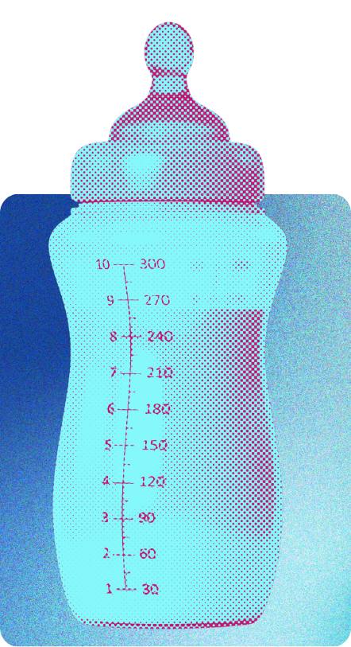
DAY 1 · FOUNDATIONAL GENDER KNOWLEDGE
STATEMENT 2:
Women can breastfeed babies, men can bottle-feed babies.
Activity 1.6 - Vote with your feet: Gender vs Sex
TRAINING OF TRAINERS MANUAL
Notes:
11

Slide 14

DAY 1 · FOUNDATIONAL GENDER KNOWLEDGE
STATEMENT 3:
In some cultures, if a woman climbs a mango tree, the tree will not bear fruit. If a man climbs a mango tree, the tree will be fine.
Activity 1.6 - Vote with your feet: Gender vs Sex
TRAINING OF TRAINERS MANUAL
Notes:
12

Slide 15

DAY 1 · FOUNDATIONAL GENDER KNOWLEDGE
STATEMENT 4:
According to UN statistics, women do 67 per cent of the world's work, yet their earnings amount to only 10 per cent of the world's income.
Activity 1.6 - Vote with your feet: Gender vs Sex
TRAINING OF TRAINERS MANUAL
Notes:
13

Slide 16

DAY 1 · FOUNDATIONAL GENDER KNOWLEDGE
STATEMENT 5:
Women give birth to babies, men don't.
Activity 1.6 - Vote with your feet: Gender vs Sex
TRAINING OF TRAINERS MANUAL
Notes:
14

Slide 17

DAY 1 · FOUNDATIONAL GENDER KNOWLEDGE
STATEMENT 6:
Amongst agricultural workers, women are paid significantly less than men.
Activity 1.6 - Vote with your feet: Gender vs Sex
TRAINING OF TRAINERS MANUAL
Notes:
15

Slide 18
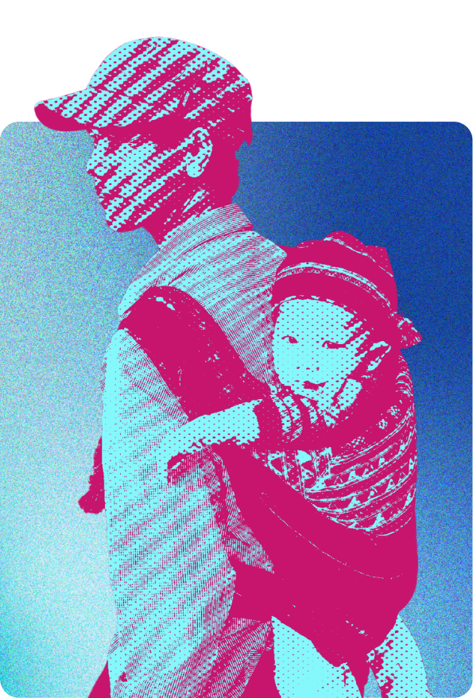
DAY 1 · FOUNDATIONAL GENDER KNOWLEDGE
STATEMENT 7:
Women carry their children on their backs; men do not.
Activity 1.6 - Vote with your feet: Gender vs Sex
TRAINING OF TRAINERS MANUAL
Notes:
16

Slide 19

DAY 1 · FOUNDATIONAL GENDER KNOWLEDGE
STATEMENT 8:
Women cannot enter some religious sites as it will become unholy.
Activity 1.6 - Vote with your feet: Gender vs Sex
TRAINING OF TRAINERS MANUAL
Notes:
17

Slide 20

DAY 1 · FOUNDATIONAL GENDER KNOWLEDGE
STATEMENT 9:
Boys don't cry, girls cry.
Activity 1.6 - Vote with your feet: Gender vs Sex
TRAINING OF TRAINERS MANUAL
Notes:
18

Slide 21

DAY 1 · FOUNDATIONAL GENDER KNOWLEDGE
STATEMENT 10:
Women love shopping, men love exercising.
Activity 1.6 - Vote with your feet: Gender vs Sex
TRAINING OF TRAINERS MANUAL
Notes:
19

Slide 22
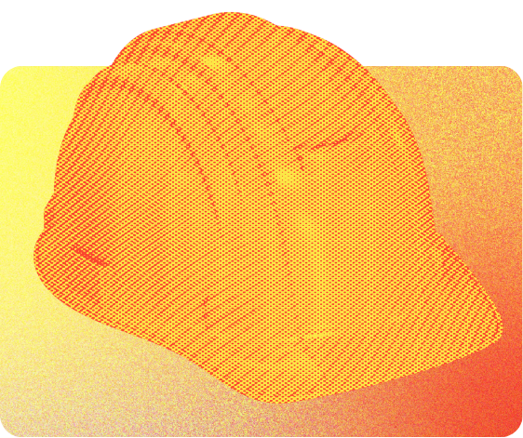
DAY 1 · FOUNDATIONAL GENDER KNOWLEDGE
STATEMENT 11:
Most construction workers are men.
Activity 1.6 - Vote with your feet: Gender vs Sex
TRAINING OF TRAINERS MANUAL
Notes:
20

Slide 23

DAY 1 · FOUNDATIONAL GENDER KNOWLEDGE
STATEMENT 12:
A man's voice "breaks" during puberty, while a woman's voice does not.
Activity 1.6 - Vote with your feet: Gender vs Sex
TRAINING OF TRAINERS MANUAL
Notes:
21

Slide 24


DAY 1 · FOUNDATIONAL GENDER KNOWLEDGE
THIS IS THE GENDERBREAD PERSON
EXPRESSION
IDENTITY
ATTRACTION
SEX
Activity 1.7 - Introducing the Genderbread Person
TRAINING OF TRAINERS MANUAL
Notes:
23

Slide 25

DAY 1 · FOUNDATIONAL GENDER KNOWLEDGE
THIS IS THE GENDERBREAD PERSON
Means a lack of what's on the right side
GENDER IDENTITY
GENDER EXPRESSION
ANATOMICAL SEX
Woman-ness
Man-ness
Femininity
Masculinity
Female-ness
Male-ness
IDENTITY ≠ EXPRESSION ≠ SEX
SEX ASSIGNED AT BIRTH
GENDER ≠ SEXUAL ORIENTATION
Female
Intersex
Male
Activity 1.7 - Introducing the Genderbread Person
TRAINING OF TRAINERS MANUAL
Notes:
23

Slide 26
DAY 1 · FOUNDATIONAL GENDER KNOWLEDGE
GENDER IS BEST UNDERSTOOD WHEN BROKEN INTO THREE PARTS:
  Gender identity:
    Gender identity can be thought of as the aspects of being a man or woman that you either do or don't align with – the social norms, and roles and expectations placed upon "men" and "women" in a society.
    Shaped by social constructs, can evolve overtime.
  Gender expression
    How people outwardly present their gender (clothing, hairstyle, grooming, mannerisms).
  Biological/anatomical sex
    Refers to the physical characteristics of a person's body, such as reproductive organs, chromosomes, and hormones.
Activity 1.7 - Introducing the Genderbread Person
TRAINING OF TRAINERS MANUAL
Notes:
25

Slide 27

DAY 1 · FOUNDATIONAL GENDER KNOWLEDGE
GENDER VS SEXUALITY
SEXUALLY ATTRACTED TO...
Women and/or Feminine and/or Female People
Men and/or Masculine and/or Male People
ROMANTICALLY ATTRACTED TO...
Women and/or Feminine and/or Female People
Men and/or Masculine and/or Male People
Activity 1.7 - Introducing the Genderbread Person
TRAINING OF TRAINERS MANUAL
Notes:
26

Slide 28
DAY 1 · FOUNDATIONAL GENDER KNOWLEDGE
GENDER VS SEXUALITY
  What have you learned?
  How did this session make you feel? What new awareness have you acquired from it?
  Is this understanding of sex and gender different to what you have been taught? In what way is it different? Where does your understanding of sex and gender come from?
  What are some of the benefits of a non-binary understanding of gender? What are some of the challenges?
  How might this be relevant for our work and our life?
Activity 1.7 - Introducing the Genderbread Person
TRAINING OF TRAINERS MANUAL
Notes:
27

Slide 29



DAY 1 · FOUNDATIONAL GENDER KNOWLEDGE
WHAT ARE SOCIAL NORMS?
Social norms are shaped by:
Maintained by social influence:
Breaking norms can lead to:
  Beliefs about what others do
  Anticipation of approval or disapproval for actions
  Social backlash
  Beliefs about what others expect you to do
  Loss of power or status in the community
Activity 1.9 - Gender and social norms
TRAINING OF TRAINERS MANUAL
Notes:
28

Slide 30
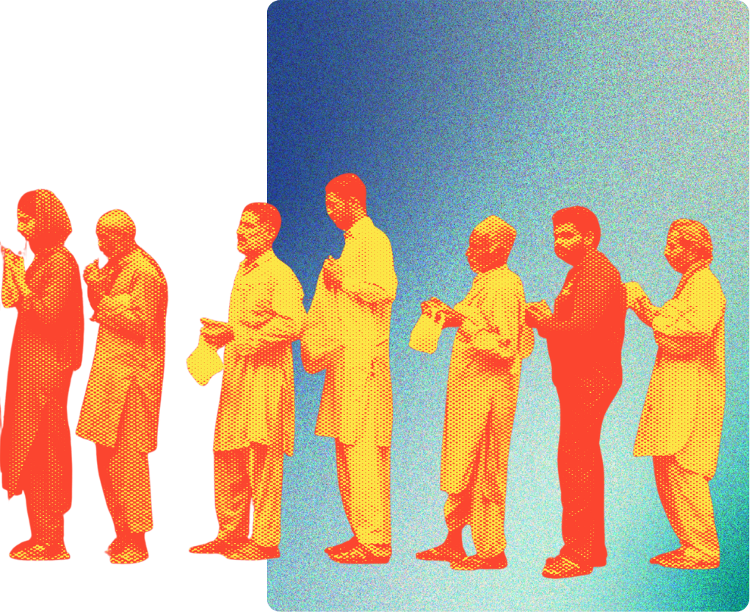
DAY 1 · FOUNDATIONAL GENDER KNOWLEDGE
EXAMPLE OF A SOCIAL NORM
Waiting in line for service.
People do this because they expect…
  everyone around them will also wait in line
  others expect them to also wait in line
  others will react negatively if they try to skip the line
Activity 1.9 - Gender and social norms
TRAINING OF TRAINERS MANUAL
Notes:
29

Slide 31


DAY 1 · FOUNDATIONAL GENDER KNOWLEDGE
REFLECT ON THE FOLLOWING:
15 mins
1. The lives of your grandmothers, mothers, and women in your own generation;
2. The lives of your grandfathers, fathers, and men in your own generation; or
3. The lives of LGBTQ people in your grandparents' generation, your parents' generation, and your own generation.
Focus on the following questions:
  Have you observed any changes in gender roles between your grandmothers’, and mothers' generations? What roles and restrictions have stayed the same?
  What changes do you see in your own lives with reference to the conditions faced by your grandmothers and mothers?
  How have these changes been possible? What were the influencing factors?
Activity 1.10 - Changing social norms
TRAINING OF TRAINERS MANUAL
Notes:
30

Slide 32

DAY 1 · FOUNDATIONAL GENDER KNOWLEDGE
One day you find a condom in your 16-year-old sister's school bag.
What would you do?
Activity 1.11 - What would you do?
TRAINING OF TRAINERS MANUAL
Notes:
31

Slide 33
DAY 1 · FOUNDATIONAL GENDER KNOWLEDGE
You are having dinner at a restaurant and suddenly see your best friend's husband dining with another woman you don't know. They seem to be pretty intimate.
What would you do?
Activity 1.11 - What would you do?
TRAINING OF TRAINERS MANUAL
Notes:
32

Slide 34
DAY 1 · FOUNDATIONAL GENDER KNOWLEDGE
Your teenage brother comes to you saying he wishes to leave home and move in with his male partner.
What would you do?
Activity 1.11 - What would you do?
TRAINING OF TRAINERS MANUAL
Notes:
33

Slide 35
DAY 1 · FOUNDATIONAL GENDER KNOWLEDGE
Your close female friend started working as a part time bartender at night. She was very happy and got a lot of tip money. However, her boyfriend started to have arguments with her and ultimately asked her to quit the job because she does not have time for him. She came to you to ask for advice. What would you do?
Activity 1.11 - What would you do?
TRAINING OF TRAINERS MANUAL
Notes:
35

Slide 36
DAY 1 · FOUNDATIONAL GENDER KNOWLEDGE
REFLECT…
  Were your own assumptions and biases at play when you determined your actions?
Activity 1.11 - What would you do?
TRAINING OF TRAINERS MANUAL
Notes:
37

Slide 37
DAY 1 · FOUNDATIONAL GENDER KNOWLEDGE
24 HOURS CLOCK
PRODUCTIVE / REPRODUCTIVE / COMMUNITY / LEISURE
TIME
TASK
Activity 1.12 - 24-Hours Clock
TRAINING OF TRAINERS MANUAL
Notes:
38

Slide 38
DAY 1 · FOUNDATIONAL GENDER KNOWLEDGE
REFLECT…
  Does this exercise reflect our own individual behaviour in our own families? If not, why do we expect different things in our home than what we perceive in our communities?
  Is our individual behavior different from what we see as normal in our community?
  How does it feel to look at this list of tasks and decisions as a man/woman? Is it fair? Why? Why not?
  Do you wish it were different? Why?
Activity 1.12 - 24-Hours Clock
TRAINING OF TRAINERS MANUAL
Notes:
39

Slide 39

TRAINING OF TRAINERS MANUAL
WORKSHOP DAY 2
FOUNDATIONAL GBV KNOWLEDGE
DATE:
DDMMYYYY
VENUE:
Insert venue here
Facilitators: click the date and venue above to type your own.
Notes:
3

Slide 40
DAY 2 · FOUNDATIONAL GBV KNOWLEDGE
TIME
ACTIVITY
NOTES
DAY 2 AGENDA
9.00
Recap of Day 1
9.30
2.1
Types of Violence
10.30
BREAK
10.45
2.2
Myths and Facts about GBV
12.00
LUNCH
13.00
2.3
Consequences of Gender Based Violence
14.30
BREAK
14.45
2.4
Mapping of Support for GBV survivors
16.00
Daily Recap
TRAINING OF TRAINERS MANUAL
Notes:
41

Slide 41
DAY 2 · FOUNDATIONAL GBV KNOWLEDGE
TYPES OF VIOLENCE:
  Physical violence includes pushing, shoving, hitting, kicking, slapping, hitting with an object, throwing objects, or other acts to attempt to harm.
  Emotional violence is behaviour such as shouting, swearing, insults, embarrassing, criticizing, threatening, extreme jealousy.
  Sexual violence refers to any sexual act, attempt to obtain a sexual act, unwanted sexual comments or advances (sexual harassment), or acts to traffic, or otherwise directed against a person's sexuality using coercion, by any person regardless of their relationship to the victim, in any setting including but not limited to home and work.
  Social and Economic violence is denying a partner control over basic resources. This includes acts such as the denial of funds, refusal to contribute financially, denial of food and basic needs, controlling access to health care and employment.
Activity 2.1 - Types of Violence
TRAINING OF TRAINERS MANUAL
Notes:
42

Slide 42
DAY 2 · FOUNDATIONAL GBV KNOWLEDGE
Violence against women has been defined as
“any act of gender-based violence that results in, or is likely to result in physical, sexual or psychological harm or suffering to women, including threats of such acts, coercion or arbitrary deprivation of liberty, whether occurring in public or private life.”
UN Declaration on Elimination of Violence Against Women.
Activity 2.1 - Types of Violence
TRAINING OF TRAINERS MANUAL
Notes:
43

Slide 43

DAY 2 · FOUNDATIONAL GBV KNOWLEDGE
SCENARIO 1
I know a woman that does not do what her husband says. He tells her to stay at home, but she goes to the market and visits her parents a lot.
I don't think he would hit her if she just did what he said.
Move to the left if you
Move to the right if you
DISAGREE
AGREE
Activity 2.2 - Facts & Myths about GBV
TRAINING OF TRAINERS MANUAL
Notes:
44

Slide 44
DAY 2 · FOUNDATIONAL GBV KNOWLEDGE
SCENARIO 2
My sister's partner hit her but she did not have any injuries.
Is this domestic violence since there are no injuries?
Move to the left if you think this is
Move to the right if you think it
NOT
IS
domestic violence.
domestic violence.
Activity 2.2 - Facts & Myths about GBV
TRAINING OF TRAINERS MANUAL
Notes:
44

Slide 45
DAY 2 · FOUNDATIONAL GBV KNOWLEDGE
SCENARIO 3
My husband and neighbour drink together. My neighbor's spouse hits her sometimes after he drinks.
Is alcohol the cause of violence?
Move to the left if you think alcohol is
Move to the right if you think alcohol
NOT
IS
the cause of violence.
the cause of violence.
Activity 2.2 - Facts & Myths about GBV
TRAINING OF TRAINERS MANUAL
Notes:
44

Slide 46
DAY 2 · FOUNDATIONAL GBV KNOWLEDGE
SCENARIO 4
Children were in the home when their father threw plates at their mother. The plates did not hit the children so I don't think the abuse affects them.
Move to the left if you think the children
Move to the right if you think children were
WERE AFFECTED
NOT AFFECTED
by this incident.
by this incident.
Activity 2.2 - Facts & Myths about GBV
TRAINING OF TRAINERS MANUAL
Notes:
44

Slide 47
DAY 2 · FOUNDATIONAL GBV KNOWLEDGE
SCENARIO 5
I work in a restaurant. Men constantly make sexual innuendos towards me or try to touch me.
Is this considered sexual harassment?
Move to the left if you think this is
Move to the right if you think this is
FLIRTING.
SEXUAL HARASSMENT.
Activity 2.2 - Facts & Myths about GBV
TRAINING OF TRAINERS MANUAL
Notes:
44

Slide 48
DAY 2 · FOUNDATIONAL GBV KNOWLEDGE
MAPPING SUPPORT FOR GBV SURVIVORS
Task
Create a community map showing key locations and services (e.g., Police station, Hospital/clinic/health center, community office & village chief’s house, Village mediation unit, relevant government & non‑government offices, services mentioned in earlier discussions).
Instructions
Use simple symbols or drawings (house, hospital, clinic) instead of words.
Group Work
After completing the map, each group should:
  Identify barriers to accessing services (distance, costs, lack of information, stigma).
  Discuss solutions to improve access and strengthen support for survivors.
Presentations (10 minutes)
Each group presents their map, highlighting:
  Resources available to support survivors of gender‑based violence.
  Barriers that make it difficult to seek help.
  Ideas for improving community response and support systems.
Activity 2.4 - Mapping support for GBV survivors
TRAINING OF TRAINERS MANUAL
Notes:
50

Slide 49

TRAINING OF TRAINERS MANUAL
WORKSHOP DAY 3
GBV AND CONSERVATION
DATE:
DDMMYYYY
VENUE:
Insert venue here
Facilitators: click the date and venue above to type your own.
Notes:
3

Slide 50
DAY 3 · GBV AND CONSERVATION
TIME
ACTIVITY
NOTES
DAY 3 AGENDA
9.00
Recap of Day 2
9.30
3.1
GBV and Gendered Climate Mapping
10.30
BREAK
10.45
3.2
Increasing Women Participation
12.00
LUNCH
13.00
Presentation of Group Work
13.30
Daily Recap
TRAINING OF TRAINERS MANUAL
Notes:
3

Slide 51
DAY 3 · GBV AND CONSERVATION
GBV AND GENDERED CLIMATE RISKS MAPPING
1.
2.
3.
4.
Review flip chart: Each group reviews the women's 24‑hour clock from the previous activity.
Select category: Choose one occupational role for a hypothetical middle‑aged person familiar to the group (e.g., woman farmer, fisherfolk, pastoralist, street vendor, home‑based worker, garment worker). Indicate gender — we encourage you to choose a woman!
Define location: Narrow down the geographical setting of this person.
List activities: Identify all daily and seasonal activities undertaken by her within a 24‑hour period.
Then…
Activity 3.1 - GBV and Gendered Climate Risks Mapping
TRAINING OF TRAINERS MANUAL
Notes:
53

Slide 52
DAY 3 · GBV AND CONSERVATION
GBV AND GENDERED CLIMATE RISKS MAPPING
TIME | SECTOR (PRODUCTIVE/ REPRODUCTIVE / COMMUNITY / LEISURE) | WORK | CLIMATE OR ENVIRONMENTAL RISKS ASSOCIATED WITH THE WORK | ASSOCIATED GBV RISK
4 AM - 8 AM
8 AM - 12 PM
12 PM - 4 PM
4 PM - 8 PM
8 PM - 12 AM
5.
Chart activities: Record the activities on a chart using the sample format provided.
Activity 3.1 - GBV and Gendered Climate Risks Mapping
TRAINING OF TRAINERS MANUAL
Notes:
54

Slide 53
DAY 3 · GBV AND CONSERVATION
INCREASING WOMEN'S PARTICIPATION
1.
What barriers do women and other marginalized groups face in order to participate in conservation-related activities, or to raise their voices on these issues? Are they facing these barriers at different levels?
2.
How would you address each barrier?
3.
What are the resources that you need in order to do that? Where can you find support?
USE THE TEMPLATE BELOW TO SUMMARIZE:
LEVEL | BARRIERS | HOW TO ADDRESS | RESOURCES NEEDED
Women themselves | e.g. Lack of confidence and skill
Family | e.g. Partner or family are not supportive. Burdened by household work
Community | e.g. Community does not allow women to join the committee.
Activity 3.2 - Increasing women's participation
TRAINING OF TRAINERS MANUAL
Notes:
55

Slide 54
DAY 3 · GBV AND CONSERVATION
REFLECT ON THE FOLLOWING IN YOUR GROUPS
1.
What are the barriers that women face in order to participate in climate change-related activities, or to raise their voices on these issues? Are they facing these barriers at different levels?
2.
How would you address each barrier?
3.
What are the resources that you need in order to do that? Where can you find support?
USE THE TEMPLATE BELOW TO SUMMARIZE:
LEVEL | BARRIERS | HOW TO ADDRESS | RESOURCES NEEDED
Women themselves | e.g. Lack of confidence and skill
Family | e.g. Partner or family are not supportive. Burdened by household work
Community | e.g. Community do not accept women to join the committee.
Activity 3.2 - Increasing women's participation
TRAINING OF TRAINERS MANUAL
Notes:
55

Slide 55

TRAINING OF TRAINERS MANUAL
WORKSHOP DAY 4
PRACTICE YOUR FACILITATION SKILLS!
DATE:
DDMMYYYY
VENUE:
Insert venue here
Facilitators: click the date and venue above to type your own.
Notes:
3

Slide 56
DAY 4 · PRACTICE YOUR FACILITATION SKILLS!
TIME
ACTIVITY
NOTE
DAY 4 AGENDA
9.00
Recap of Day 3
9.30
Key components of gender training What to prepare for the gender training (see p.13-14)
10.30
BREAK
10.45
4.1
Activity simulation (30 mins for each group)
12.00
LUNCH
13.00
4.1
Activity simulation (continued) and Feedback session
14.00
Dealing with resistance (see p.13-14, p.27)
14.45
BREAK
15.00
4.2
Post Assessment, workshop evaluation
15.30
4.2
Closing
TRAINING OF TRAINERS MANUAL
Notes:
3

Slide 57
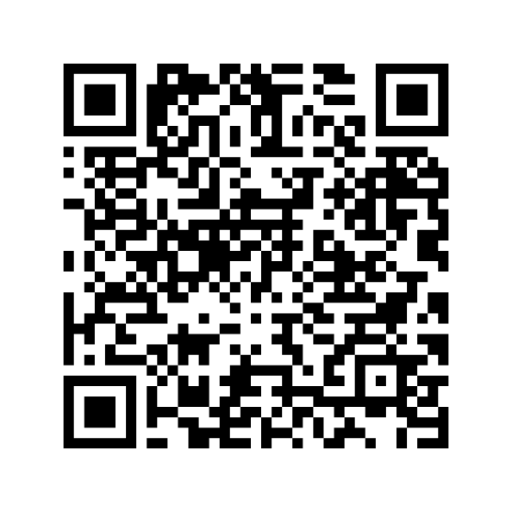

DAY 4 · PRACTICE YOUR FACILITATION SKILLS
OR CLICK HERE
Refer to the ToT manual for details on specific activities!
TRAINING OF TRAINERS MANUAL
Notes:
59

Slide 58



WWF and Australia Government Department of Foreign Affairs and Trade are working identify, prevent, and respond to Gender-Based Violence.
Notes:
59

